Slide 1
Text Mining Group Project
Group 4:
Chandra Harsha Alla
Nimish Pastaria
Pratik More
Sri Vinay
Zilon Mao

Slide 2

PROBLEM STATEMENT
Develop a predictive model that accurately forecasts weekly sales for a Walmart store by considering historical sales data and other non-intuitive predictive parameters including temperature, fuel prices, unemployment rates in the state, holidays and Consumer Price Index (CPI) information.

Slide 3
RELEVANCE
Optimize inventory management
Timely delivery of stock
Improving operational efficiency and profitability
Improving staffing schedules
Reduce operational costs

Slide 4
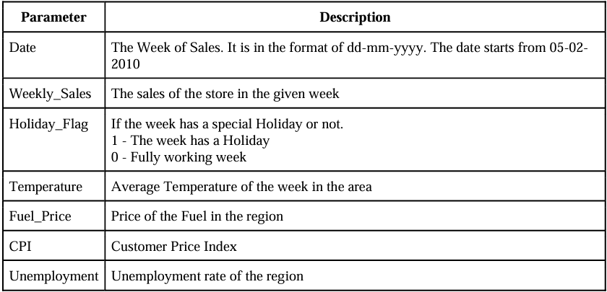
DATA DESCRIPTION

Slide 5
Process
Data Preparation
Exploratory Data Analysis
Feature Engineering
Model Building in SAS
Model Evaluation and Selection
Evaluating the Work

Slide 6
References
Kaggle- Walmart Sales Dataset of 45stores (kaggle.com)

